Slide 1
Improving Travel Forecasting Accuracy Present & Future
2025 Modeling Mobility Conference
September 15, 2025
Notes:
Good morning, everyone!
This morning I’m going to discuss the present and upcoming activities of a project we’re working with FHWA named Improving Travel Forecasting Accuracy.

Slide 2

Topics
Background
Project Overview
Accuracy Assessment Toolkit (Beta Version)
Looking ahead: Incorporating ideas
Notes:
First, I’ll provide an overview of the project,
then I’ll describe the recently released materials.
>Finally, I’ll discuss the next phase,
which will be the main focus of my presentation.
I’ll be looking for some ideas from you for that.

Slide 3
Present Work
Agency Interviews
Conduct agency interviews to gather travel data & travel demand forecasts from States and MPOs to compare forecasts to observed data
Toolkits
Use results to develop tools & guidance for states/MPOs to support more accurate travel demand forecasting
Notes:
For the first phase of the project, the motivation for the project is Section 11205 of the Infrastructure Investment and Jobs Act (IIJA).
In the first part of section 11205, it discusses the need to support more accurate travel demand modeling.
We interviewed 6 agencies from around the country to learn
about how they think about accuracy and
how that can inform more accurate travel demand forecasting.
>Now we aren’t literally following 11205, but using it as our guiding light.

Slide 4
Toolkit Contents (for Beta-Testing)
Category | Item | Regional Forecasting Toolkit | Traffic Forecasting Toolkit
Documents | Improving Travel Forecasting Accuracy Guidance document The “starting point” document. It describes both toolkits. | √ | √
 | Traffic Accuracy Assessment User’s Guide Installation & user guide for the Quarto/Python routine for traffic forecasting agencies. |  | √
Scripts | Sample script using Google Places API (“Places_API.R”) Provides a workable example to use the Google Places API. | √
 | Sample script for GTFS comparisons (“GTFSITC.R”) Compares two GTFS networks. | √
 | Sample script using Google API (“RoutesAPI.R”) Uses the Google API to extract reliable congested travel times. | √
 | Large-N Traffic Accuracy Assessment script and associated files Executes a traffic accuracy assessment report and generates output in HTML or PDF |  | √
Examples | Traffic Accuracy Assessment Report (Large-N) Example PDF output of the Quarto/Python routine. |  | √
 | Traffic Accuracy Assessment Data workbook Excel workbook for archiving traffic forecasts and counts as they occur. |  | √
Notes:
Those conversations lead us to develop accuracy assessments toolkits for agencies.
These toolkits consist of guidance documents and automated routines & scripts.
We’ve developed materials for
traffic forecasting, which is a large part of forecasting in the US, and
regional forecasting, where the longer time horizons require a different focus.
>These materials are currently available to anyone who wants to use them for beta-testing.

Slide 5
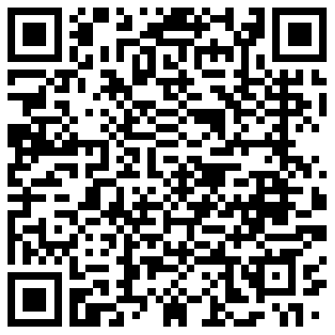
You Can Download the Toolkit to Best-Test
Please use & provide feedback by October 31st via email to:
Hailey Amundson hailey.amundson@insighttcinc.com
David Schmitt, AICP david.schmitt@insighttcinc.com
Sarah Sun sarah.sun@dot.gov
Notes:
You can download the toolkits using this QR link.
If you’re interested, please download and use them.
We’re interested in your feedback.
To keep our project on schedule, we’d like to get your feedback by the end of next month.
Just email myself, David (manager), and Sarah Sun (project manager) by the end of next month.
You don’t need to email us to get the toolkit, you just need to use the QR code for that.
>I’ll also be providing the QR code at the end of the presentation, and you can ask me after this session for the link also.

Slide 6
Looking Ahead
Accurate forecasts come from good travel models
Good travel models are based on good, reliable data
So…what new or emerging datasets can really improve travel models?
Notes:
Accurate forecasts come from good models, and
good models come from the application of good, reliable data
using good modeling practice.
>We’re beginning to think about datasets that can help agencies improve their modeling practice.
And that’s what we’d love to hear from you all today.

Slide 7
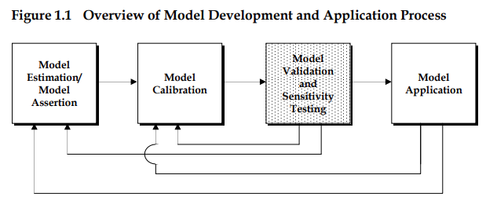
What Data Would Most Advance Your Modeling Practice?
Questions
What dataset is most applicable for resolving the biggest challenge?
What are the data gaps that have the highest needs?
Is there data you can’t collect or is cost-prohibitive, but would really improve modeling practice?
Are there new or emerging data you would like to apply to your model?
Modeling practice includes:
Estimation,
Calibration,
Validation,
Sensitivity Testing,
Application,
Forecasting
Picture source: “Travel Model Validation and Reasonableness Checking Manual,” 1-5, Figure 1.1, 2010.
Notes:
Now by practice, we mean every phase of the modeling lifecycle: estimation, calibration, validation, and forecasting.
Think about the data you currently use as you develop and apply your models, I’m sure you all use a vast number of different datasets. What we’d like to know is things like:
- What are the gaps in your datasets?
- Is there data that you can’t collect or can’t afford to collect, but would really help improve estimation, calibration, or validation?
- Are there any new types of data that you would like to use?
The reason why we’d like your input today is because we have been asked to provide some suggested answers to these same questions.
We aren’t at a point where we can discuss funding or collecting any dataset that you mention here today…it’s way too soon for that.
In this next phase of our project, our charge is to identify data or datasets - which may exist today or not - that would have the biggest impact on improving modeling practice nationally.
Rather than interviewing agencies individually, we’re taking this opportunity to ask everyone

Slide 8
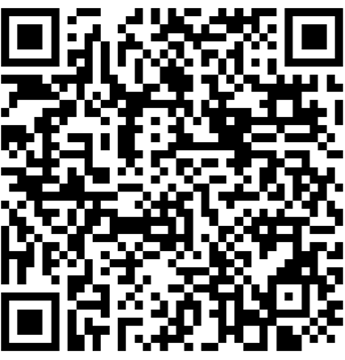
What Data Would Most Advance Your Modeling Practice?
You can provide your input via email by October 31st
Hailey Amundson hailey.amundson@insighttcinc.com
David Schmitt, AICP david.schmitt@insighttcinc.com
Sarah Sun sarah.sun@dot.gov
Notes:
We would be happy to get your thoughts in one of three ways.
We’re happy to talk about your comments during this session.
2. You can also provide us your ideas and thoughts on this question using this QR code, which
asks some basic questions up front and
gives you the ability to provide your thoughts to our key question.
3. If you want to think about some ideas, you can email us over the next couple of weeks.
(maybe get live data suggestions/ideas from the audience at this time)

Slide 9
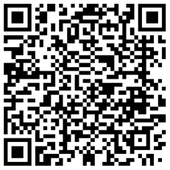

Thank You!
Link to access guidance toolkit
Survey link to provide data ideas & suggestions
Notes:
Thank you for providing your ideas this morning!
Here are links to both
the toolkit materials and
to provide ideas on our critical data question.
We’ll keep our survey link active for the rest of the conference.
I’m happy to chat with you after this session. Thanks so much!

